Slide 1
WEB TECH PROJECT
BY,
AKASH C N [PES1UG22CS058]
ABHISHEK [PES1UG22CS018]
ADITYA R MIRJI [PES1UG22CS042]

Slide 2
WE SEE HERE
AAA FITNESS
Introduction
Topics Used
Team members contribution
Website screen shots
Summary

Slide 3
INTRODUCTION
Welcome, everyone, to our presentation showcasing the innovative world of fitness through our meticulously designed website. In a society increasingly prioritizing health and well-being, our project aims to revolutionize the way individuals engage with their fitness journeys. Our website serves as a comprehensive platform, merging technology with wellness, to inspire, educate, and empower users on their quest for a healthier lifestyle. Join us as we delve into the features, functionality, and the underlying vision driving this dynamic fitness portal ​

Slide 4
TOPICS USED
HTML
CSS
JAVA SCRIPT
REACT JS
MONGO DB
DATABASE MANAGEMENT

Slide 5

CONTRIBUTION OF EACH TEAM MEMBER
AKASH C N-HTML,CSS
ADITYA R-JAVA SCRIPT,REACT
ABHISHEK-MONGODB,DATABASE

Slide 6
PROJECT WEB-PAGES​

Slide 7
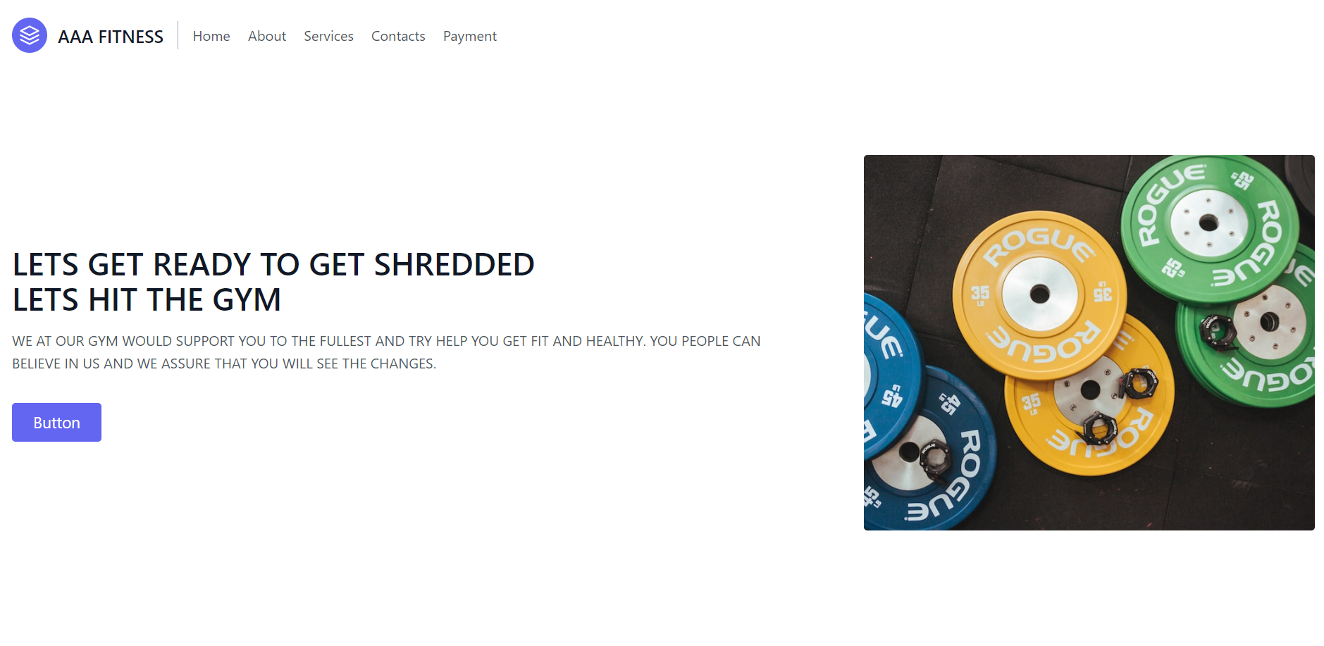
HOME PAGE

Slide 8
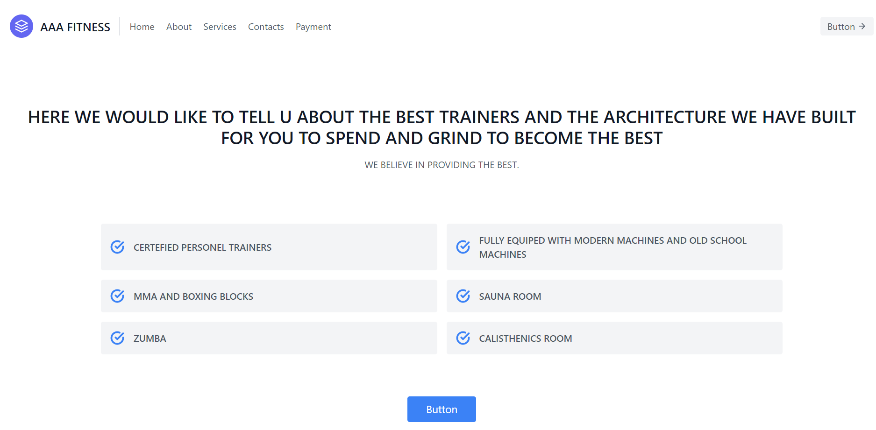
ABOUT PAGE

Slide 9
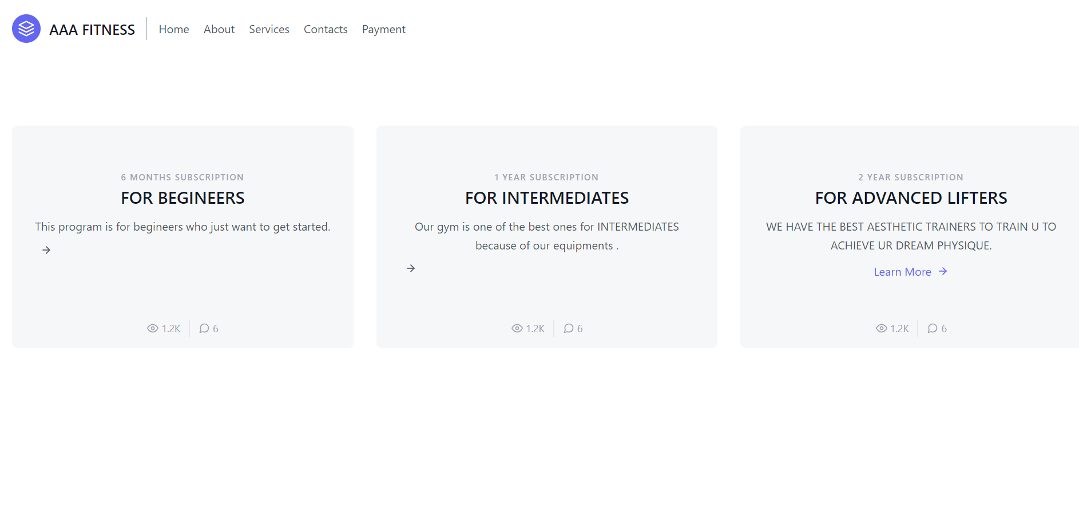
SERVICE PAGE

Slide 10
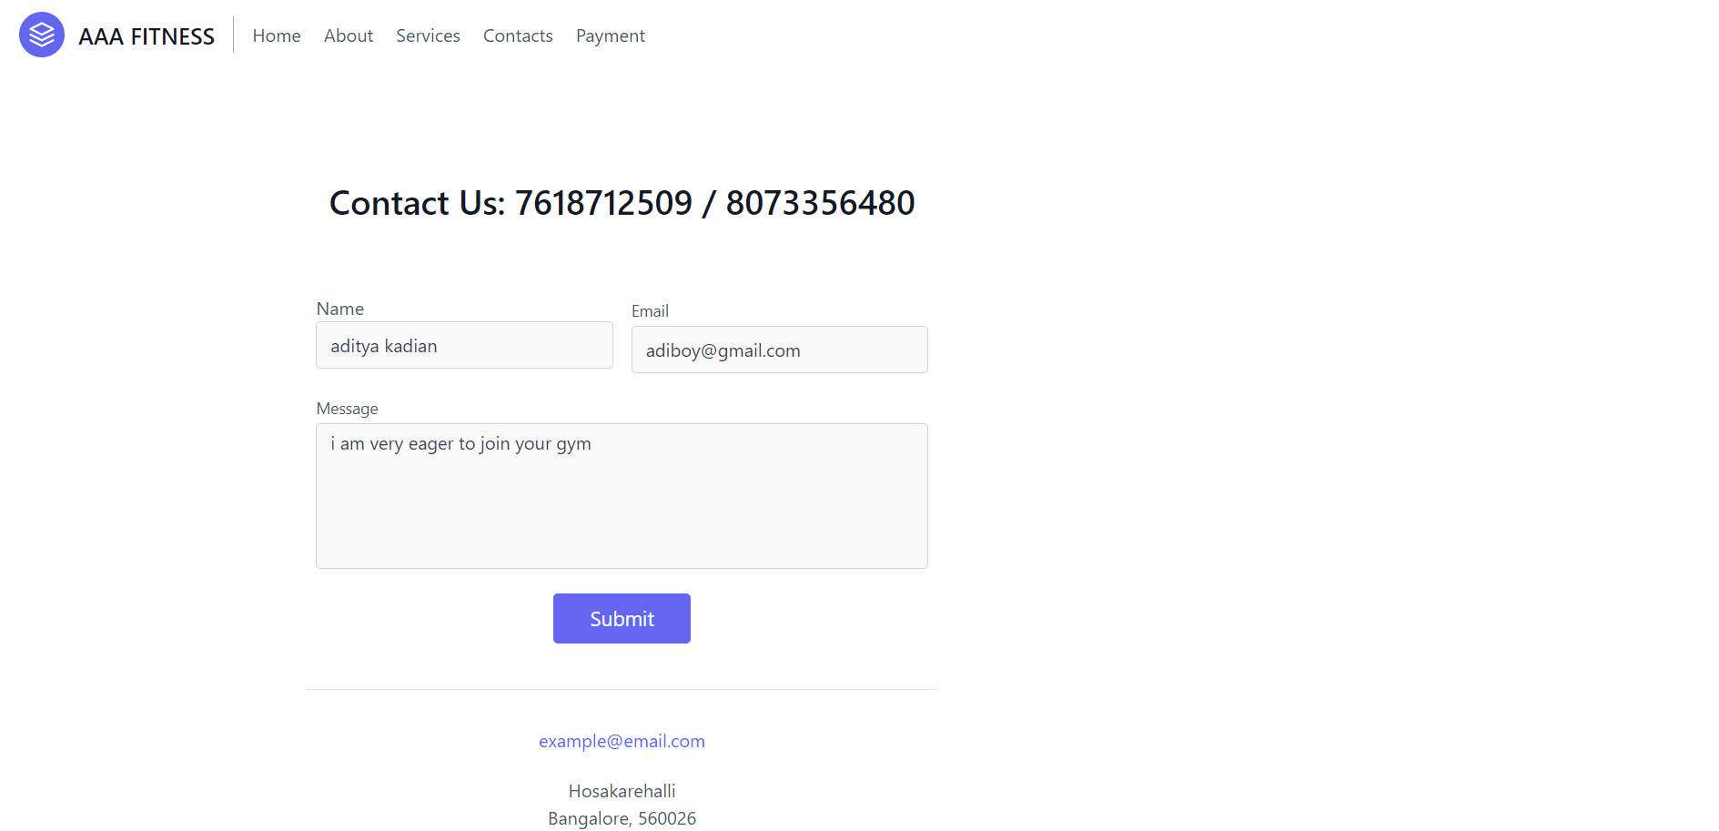
CONTACTS PAGE

Slide 11
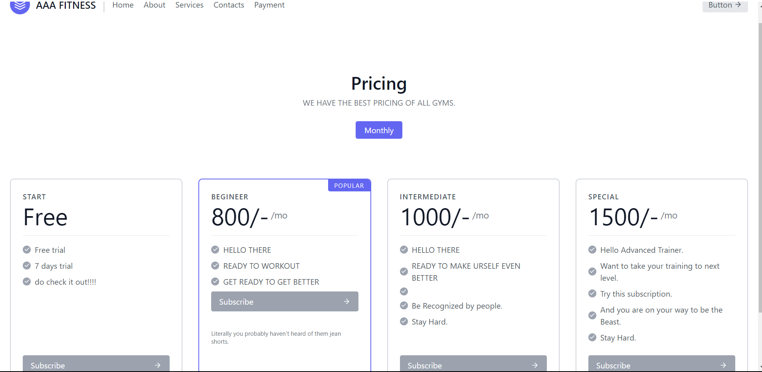
PAYMENT PAGE

Slide 12
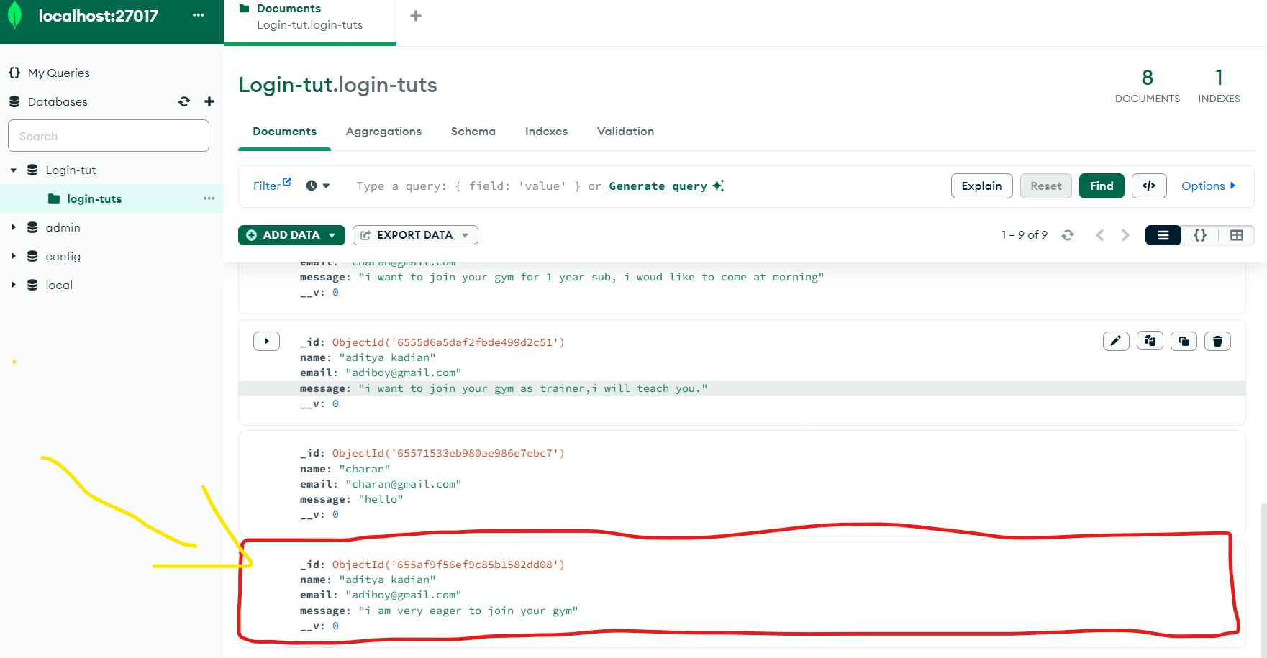
DATA IN MONGODB COMPASS

Slide 13
PLAN FOR PRODUCT LAUNCH
Deploy strategic networks with compelling e-business needs
PLANNING
Synergize scalable e-commerce
MARKETING
Disseminate standardized metrics
DESIGN
Coordinate e-business applications
Foster holistically superior methodologies
LAUNCH
STRATEGY

Slide 14
SUMMARY
Our project is centered around the development and implementation of a dynamic fitness website, curated to address the contemporary health and wellness needs of users. This innovative platform incorporates intuitive user interfaces, interactive features, and comprehensive fitness resources. Our goal is to create an engaging, accessible online space that not only educates and motivates but also fosters a sense of empowerment, enabling individuals to embark on and sustain their fitness journeys effectively.

Slide 15
THANK YOU

